Slide 1

Sensitivity of Ocean Sampling for Coupled COAMPS-TC Prediction
Sue Chen¹, James Cummings², Jerome Schmidt¹, Peter Black², Elizabeth Sanabia³, L. K. (Nick) Shay⁴
¹Naval Research Laboratory, Monterey, California
²SAIC, Monterey
³Oceanography Department, United States Naval Academy, Annapolis, Maryland
⁴Rosenstiel School of Marine and Atmospheric Science, University of Miami

Slide 2
Motivation
Explore the optimal ocean sampling strategy for Hurricane Isaac (2012) using the NCODA adjoint
Investigate the sensitivity of TC intensity change from the assimilation of the high-resolution in-situ AXBT, AXCTD, and AXCP observations

Slide 3
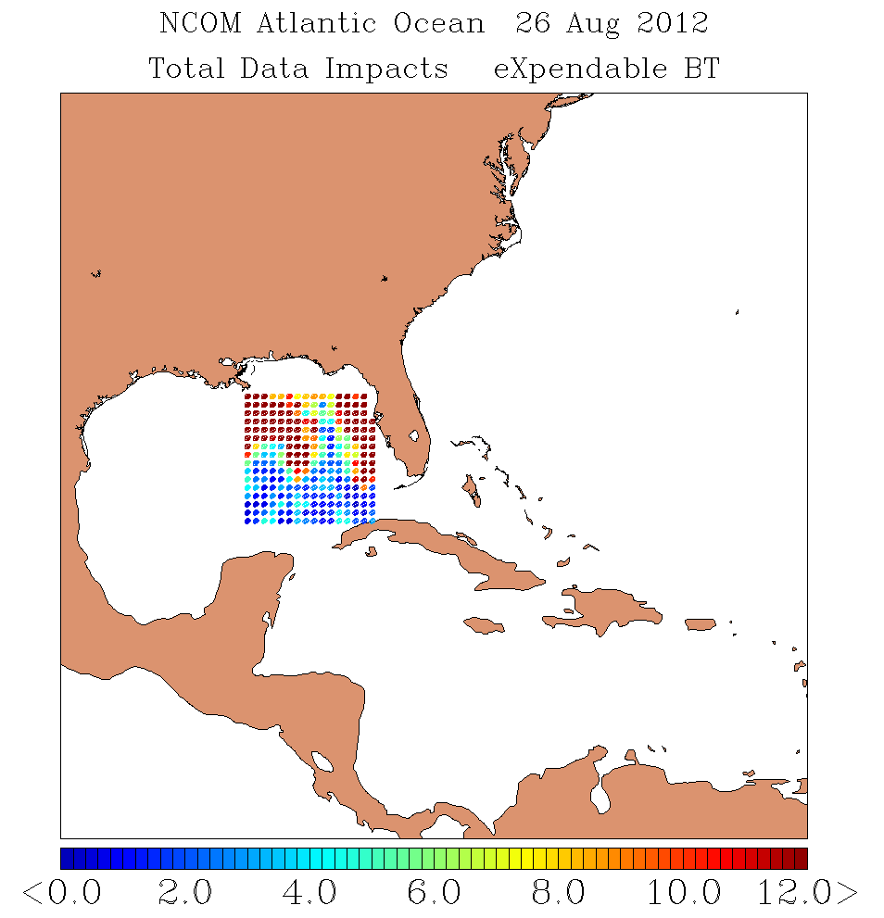
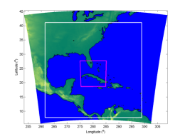
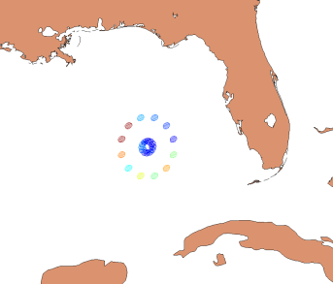
Idealized Optimal Ocean Data Sampling
Flexible idealized sampling pattern
The data impact is measured as a change in the magnitude of the forecast error
Warm color observations represent larger impact on reducing the forecast ocean temperature error
Results indicate two areas of large observation impact on the forward quadrants of the TC for this case:
  Along the TC track
  Near the Florida shelf water
Idealized ocean observations (20 km horizontal resolution) using data from the coupled COAMPS-TC Isaac (2012) simulations

Slide 4
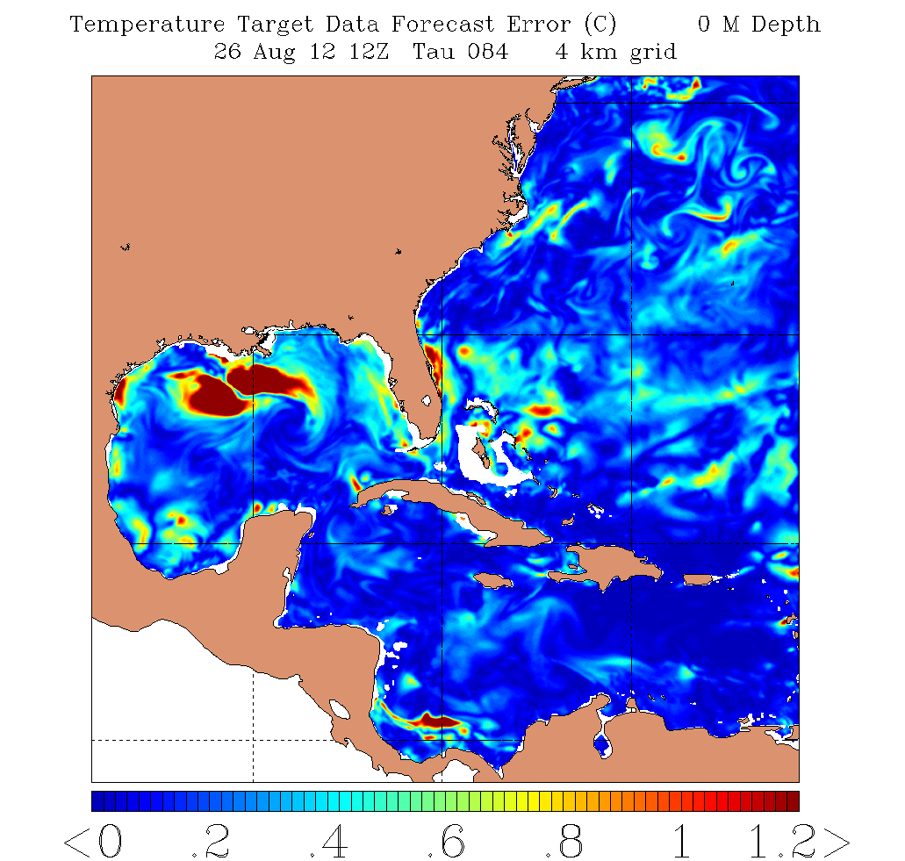
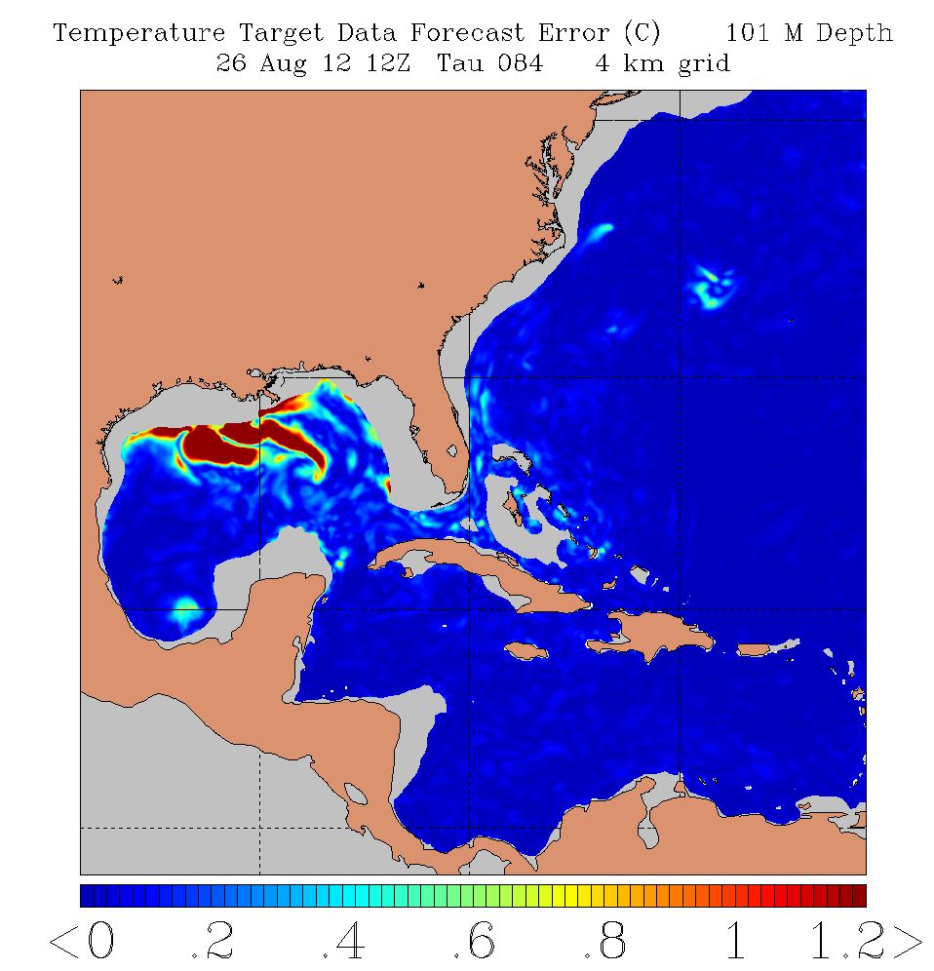
Idealized Optimal Ocean Data Sampling
Sea Surface Temperature
101 m Sea Temperature

Slide 5
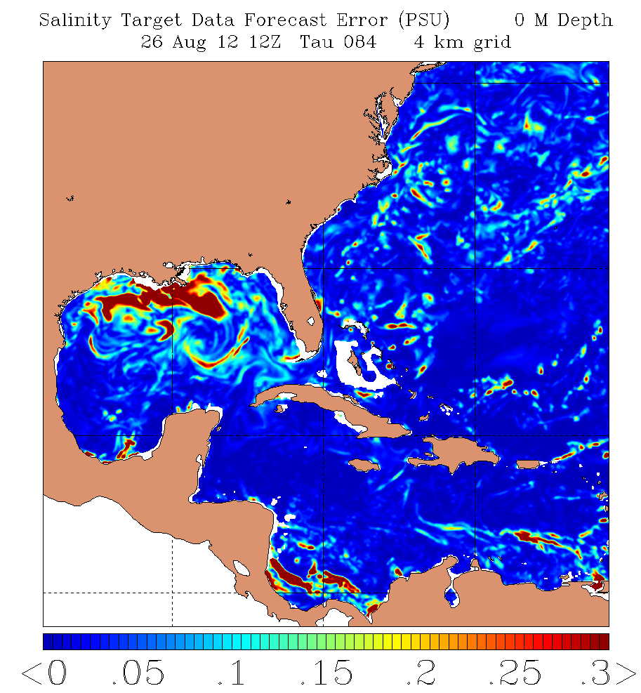
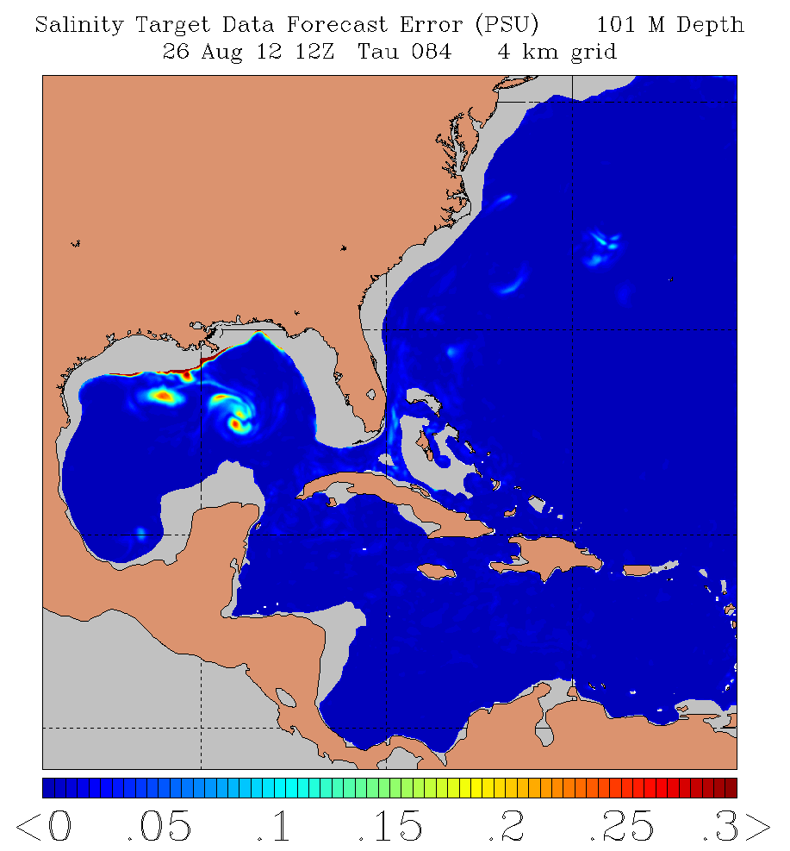
Idealized Optimal Ocean Data Sampling
Sea Surface Salinity
101 m Salinity

Slide 6
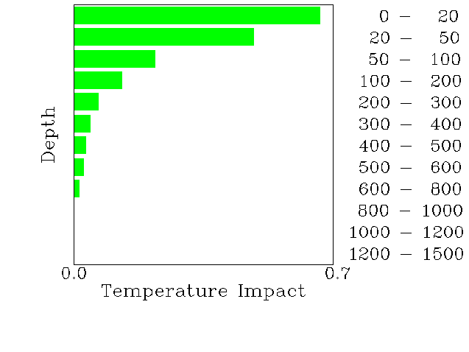
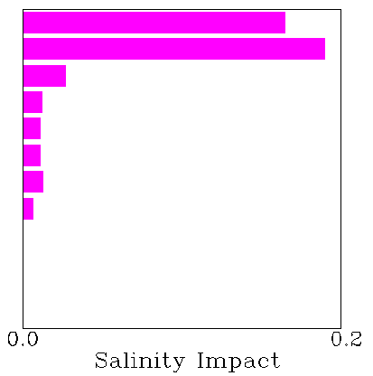
XBT Temperature Impact
XCTD Salinity Impact

Slide 7
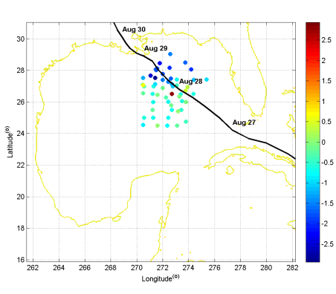
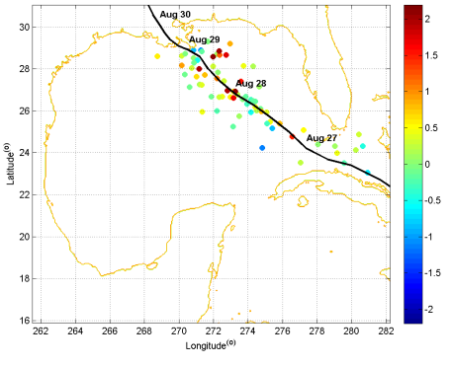

SST (°C): Observation - COAMPS analysis
Salinity (PSU) : Observation - COAMPS analysis
In-situ Observations from:
  Airborne Expendable BathyThermograph (AXBT)
  Airborne Expendable Conductivity, Temperature, Depth Profiler (CTD)
  Airborne Expendable Current Profiler (AXCP) ocean observations
Up to -2.5 °C SST and -2.9 PSU salinity changes from COAMPS analysis at 0000 UTC 25 Aug, 2012

Slide 8
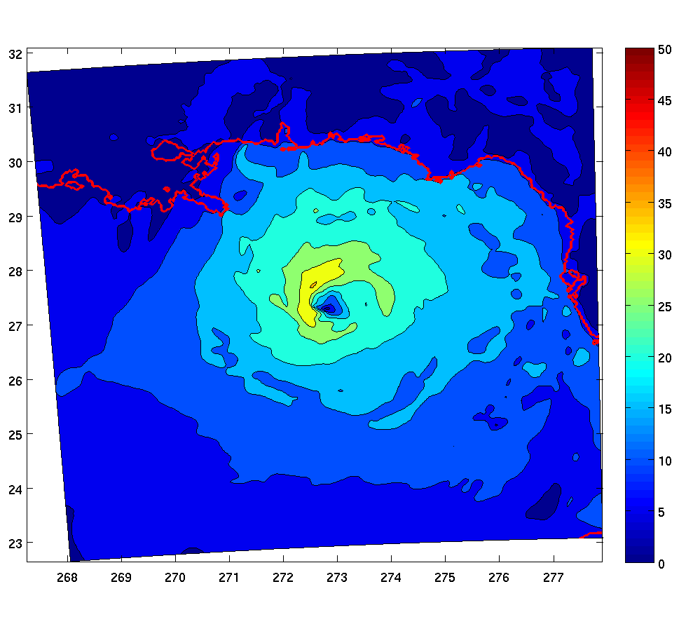
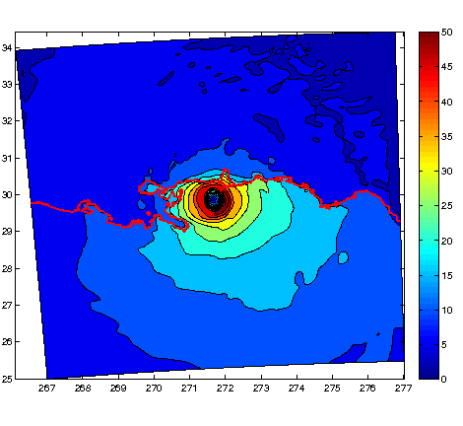
COAMPS-TC Isaac simulation: 2012082612
Wind speed: 36 H
Wind speed: 54 H

Slide 9
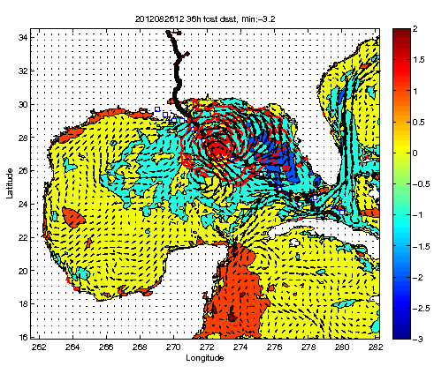
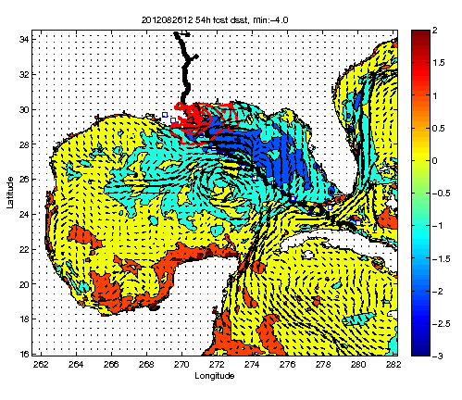
COAMPS-TC Isaac SST Change: 2012082612
36 H
54 H

Slide 10
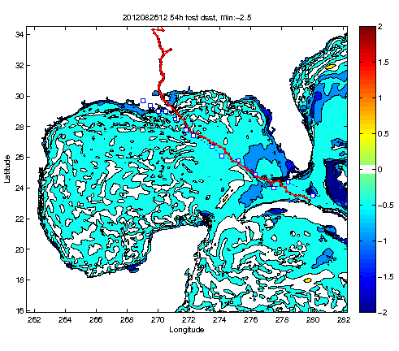
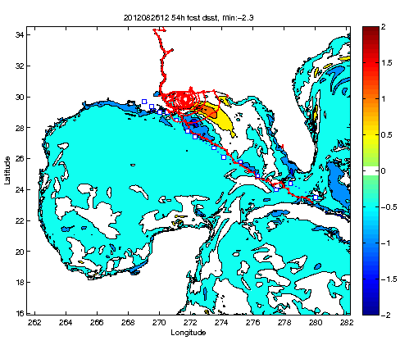
COAMPS-TC Isaac SST Change: 2012082612
Initial SST Difference
54H SST Difference

Slide 11
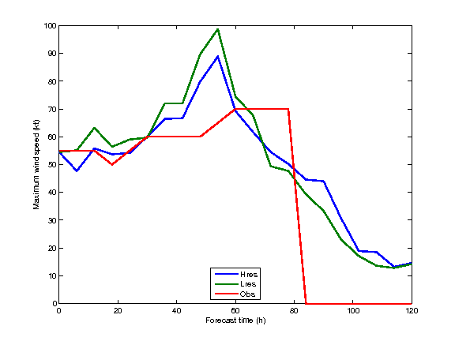
COAMPS-TC Isaac Intensity Change: 2012082612
COAMPS Landfall
Observed Landfall

Slide 12
Summary
We developed and tested a proto-type optimal sampling tool based on the 3D VAR adjoint method
The idealized optimal sampling case study performed using hurricane Isaac (2012) suggests that observations in the northern quadrants of the TC have the largest impact to the sea temperature and salinity forecasts
Assimilation of higher-resolution and more dense observations for the real-data simulation of hurricane Isaac improved the TC intensity forecast as well as the SST and sub-surface ocean temperature and salinity forecasts
The model simulated Isaac intensity change prior to landfall between these two experiments was < 10 knots
Future work includes applying the optimal ocean sampling tool to other TC cases

